Slide 1
Theory of Knowledge (TOK) in individual subjects
Oporto British School
Portugal
January 29th 2014
Roz Trudgon
IB Educator & Consultant

Slide 2
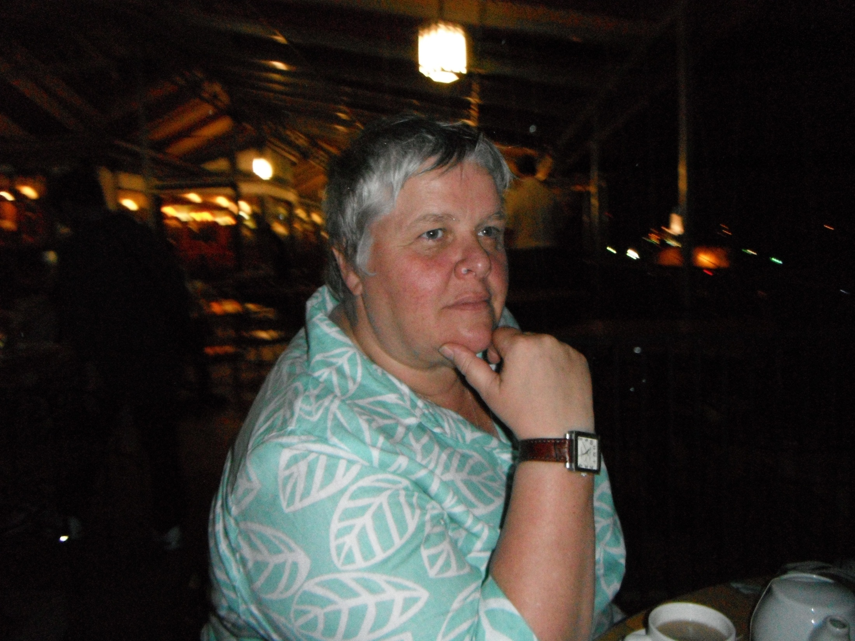
Who Am I?
Roz Trudgon
Co-Author of IB Theory of Knowledge: Skills and Practice For the IB diploma
TOK Teacher
Workshop Leader
DP Coordinator
Teacher English A
IBCC Associate Manager
Examiner
DP Consultant
DP Five Year Evaluation Consultant
Verification Visitor
IB Recognition Ambassador
IBSCA Training Officer
Dreadful Golfer!

Slide 4
TOK often produces unexpected links

Slide 5
TOK in a nutshell…
Philosophically based
Challenges conventional thinking
100 hours teaching
Assessment
Essay
Presentation
Must be considered and appear in all subjects

Slide 6
Theory of Knowledge
Theory of Knowledge (ToK) develops a coherent approach to learning that unifies the academic disciplines. In this course on critical thinking, students inquire into the nature of knowing and deepen their understanding of knowledge as a human construction. http://www.ibo.org/diploma/

Slide 7
TOK (according to the IB)
TOK plays a special role in the Diploma Programme by providing an opportunity for students to reflect on the nature of knowledge, and on how we know what we claim to know.
The fundamental question of TOK is “how do we know that?” Students are encouraged to think about how knowledge is arrived at in different disciplines, what the disciplines have in common and the differences between the disciplines.
TOK therefore both supports and is supported by the study of other DP subjects, as students are required to explore knowledge questions against the backdrop of their experiences in their other DP subjects.

Slide 8
TOK (according to the IB)
Discussion and critical reflection form the backbone of the TOK course, centring around discussions of questions such as:
what counts as evidence for X?
what makes a good explanation in subject Y?
how do we judge which is the best model of Z?
how can we be sure of W?
what does theory T mean in the real world?
how do we know whether it is right to do S?
Through discussions of these types of questions students gain greater awareness of their personal and ideological assumptions, as well as developing an appreciation of the diversity and richness of cultural perspectives.

Slide 9
Knowledge Questions
Knowledge questions are open questions about knowledge
Instead of focusing on specific content, they focus on how knowledge is constructed and evaluated
Knowledge Questions should inquire into the nature of knowledge, the potential obstacles, AND the mechanisms for overcoming obstacles.

Slide 10
Your subject and TOK
In your subject guide read through the aims of your subject
Compare them to the aims of TOK
What are the similarities?
How does TOK fit into your subject?

Slide 11
The overall aim of TOK is
to encourage students to formulate answers to the question “how do you know?” in a variety of contexts, and to see the value of that question. This allows students to develop an enduring fascination with the richness of knowledge.

Slide 12
Specifically, the aims of the TOK course are for students to:
1. make connections between a critical approach to the construction of knowledge, the academic disciplines and the wider world
2. develop an awareness of how individuals and communities construct knowledge and how this is critically examined
3. develop an interest in the diversity and richness of cultural perspectives and an awareness of personal and ideological assumptions
4. critically reflect on their own beliefs and assumptions, leading to more thoughtful, responsible and purposeful lives
5. understand that knowledge brings responsibility which leads to commitment and action.

Slide 13
When was the last time?
Thinking about your subject when was the last time that you asked students to respond to:
what counts as evidence for X?
what makes a good explanation in subject Y?
how do we judge which is the best model of Z?
how can we be sure of W?
what does theory T mean in the real world?
how do we know whether it is right to do S?

Slide 14
ToK Structure
What we know
AREAS OF KNOWLEDGE (AOK)
How we Know
WAYS OF KNOWING (WOK)
Knowledge Questions
Knowledge Framework
Shared/Personal Knowledge

Slide 15
Ways of Knowing (WoK)
Emotion
Language
Reason
Sense Perception
Faith
Imagination
Intuition
Memory
IB suggest that students explore 4 AoK
Notes:
Students must explore a range of WOKs. It is suggested that studying four of these eight in depth would be
appropriate. The WOKs selected for detailed study should be carefully selected to ensure a coherent and
balanced approach.

Slide 16
Areas of Knowledge (AoK)
The Arts
Ethics
History
Human Sciences
Mathematics
Natural Sciences
Religious Knowledge Systems
Indigenous Knowledge Systems
IB suggest that students explore 6 AoK
Notes:
Students must explore a range of AOKs. It is suggested that six of these eight would be appropriate.

Slide 17
Students need to…
Connect knowledge questions to real life situations in two different ways:
The Presentation requires them to extract Knowledge Questions from real-life situations
The Essay requires them to begin with a Knowledge Question and then to determine what real-life situations can shed some light on an answer to that Knowledge Question and others related to it.
Notes:
The presentation can be done individually or in a group, with a maximum group size of three. Approximately
10 minutes per presenter should be allowed, up to a maximum of approximately 30 minutes per group.
Before the presentation each student must complete and submit a presentation planning document (TK/
PPD) available in the Handbook of procedures for the Diploma Programme. The TK/PPD is internally
assessed alongside the presentation itself, and the form is used for external moderation.
1600 word essay

Slide 18
Shared/Personal Knowledge
Shared knowledge
"We know because..."
Personal knowledge
"I know because ..."
Notes:
The new model embodies the idea from the old diagram that there are “knowers” in groups and “knower” as individuals, and it indicates that there is a relationship between the two of them.

Slide 19
Shared knowledge:
highly structured;
systematic in its nature;
the product of more than one individual;
often bound together into more or less distinct areas of knowledge

Slide 20
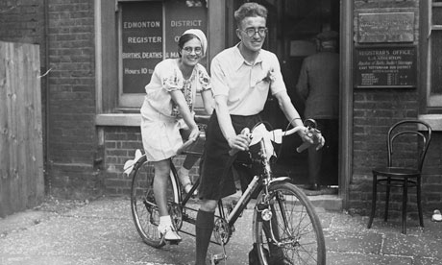
Shared knowledge:
does not solely depend upon the contributions of a particular individual;
allows for the possibility for others to check and amend individual contributions and add to the body of knowledge that already exists;
changes and evolves over time because of the continued applications of the methods of inquiry;
potentially allows international-mindedness into our exploration of knowledge questions.

Slide 21
Shared knowledge
In pairs identify examples of “Shared knowledge” in your subject or subject area.

Slide 23
Personal knowledge:
depends crucially on the experiences of a particular individual;
is gained through experience, practice and personal involvement;
is intimately bound up with the particular local circumstances of the individual such as:
biography, interests and values;
Notes:
Cristian Ronaldo

Slide 24
Personal knowledge:
contributes to, and is in turn influenced by, an individual’s personal perspective;
is made up of skills and procedural knowledge that have been acquired through practice and habituation;
is made up of what we know through experience;

Slide 25
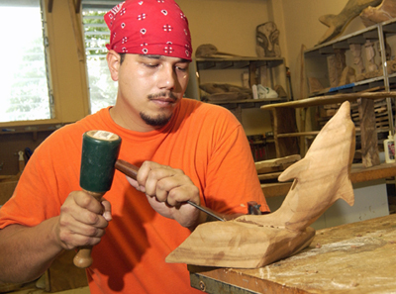
Personal knowledge:
is made up of what we have learned through formal education;
is made up of the results of personal academic research;
includes what might be described as skills, practical abilities and individual talents;

Slide 26
Personal knowledge:
is formed from a number of ways of knowing such as:
our memories of our own biography
the sense perceptions through which we gain knowledge of the world
the emotions that accompanied such sense perceptions;
is not static, but changes and evolves over time.

Slide 27
Personal Knowledge
How might a student’s “Personal knowledge” shape their learning/understanding in your subject?

Slide 28
The 1600 Word Essay
requires students to begin with a Knowledge Question and then to determine what real-life situations can shed some light on an answer to that Knowledge Question and others related to it.

Slide 29
TOK Essay Titles 2014
1. Ethical judgements limit the methods available in the production of knowledge in both the arts and the natural sciences. Discuss.
2. “When the only tool you have is a hammer, all problems begin to resemble nails” (Abraham Maslow). How might this apply to ways of knowing, as tools, in the pursuit of knowledge?
3. “Knowledge is nothing more than the systematic organisation of facts.” Discuss this statement in relation to two areas of knowledge.
4. “That which is accepted as knowledge today is sometimes discarded tomorrow.” Consider knowledge issues raised by this statement in two areas of knowledge
5.“The historian’s task is to understand the past; the human scientist, by contrast, is looking to change the future.” To what extent is this true in these areas of knowledge?
6. “A skeptic is one who is willing to question any knowledge claim, asking for clarity in definition, consistency in logic and adequacy of evidence” (adapted from Paul Kurtz, 1994). Evaluate this approach in two areas of knowledge.

Slide 30
Knowledge Framework
Scope
Language
Methodology
Historical Development
Links to Personal Knowledge

Slide 31
TOK Must be considered and appear in all subjects
Sit in subject groups
In your subject guide find the guidance on TOK Links – usually around p6/7
Read the subject linked TOK questions on the page
Working as a subject discuss:
How you might approach these questions through your teaching
Which aspects of your subject may be particularly useful in addressing the questions
Whether any of the questions are more problematic than others

Slide 32
Make a poster or TOK TIPS Sheet to help students recognise TOK in your subject

Slide 33
“Every Science begins as Philosophy and ends as Art”
William James Durant - American writer, historian, and philosopher (1885-1981)

Slide 34
Theory of Knowledge (TOK) in individual subjects
Oporto British School
Portugal
January 29th 2014
Roz Trudgon
IB Educator & Consultant

